Slide 1
Chapter 19: DMVPN Tunnels
Instructor Materials
CCNP Enterprise: Advanced Routing

Slide 2
Chapter 19 Content
This chapter covers the following content:
Generic Routing Encapsulation (GRE) Tunnels - This section explains how GRE tunnels operate and explains the configuration of GRE tunnels.
Next Hop Resolution Protocol (NHRP) - This section describes the NHRP protocol and how it dynamically maps underlay IP addresses to overlay tunnel IP addresses.
Dynamic Multipoint VPN (DMVPN) - This section explains the three DMVPN phases and the technologies involved with DMVPN tunnels.
DMVPN Configuration - This section explains the configuration of DMVPN tunnels.
Spoke-to-Spoke Communication - This section explains how spoke-to-spoke DMVPN tunnels form.

Slide 3
Chapter 19 Content (Cont.)
This chapter covers the following content:
Problems with Overlay Networks - This section describes common issues with overlay networks and provides optimal design concepts to prevent those issues.
DMVPN Failure Detection and High Availability - This section explains the DMVPN mechanisms to detect failure and methods for providing a resilient DMVPN network.
IPv6 DMVPN Configuration - This section explains how DMVPN tunnels can use IPv6 networks as an underlay or overlay network.

Slide 4
Generic Routing Encapsulation (GRE) Tunnels
A GRE tunnel provides connectivity to a wide variety of network layer protocols by encapsulating and forwarding those packets over an IP-based network.
The original use of GRE tunnels was to provide a transport mechanism for nonroutable legacy protocols such as DECnet, Systems Network Architecture (SNA), and IPX.
DMVPN uses Multipoint GRE (mGRE) encapsulation and supports dynamic routing protocols, which eliminates many of the support issues associated with other VPN technologies.
GRE tunnels are classified as an overlay network because a GRE tunnel is built on top of an existing transport network, also known as an underlay network.

Slide 5
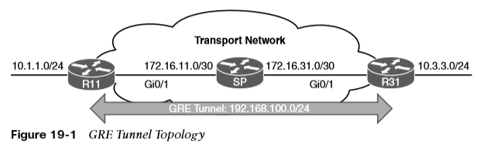
Generic Routing Encapsulation (GRE) Tunnels GRE Tunnel Configuration
Figure 19-1 illustrates the configuration of a GRE tunnel. The 172.16.0.0/16 network range is the transport (underlay) network, and 192.168.100.0/24 is used for the GRE tunnel (overlay network).
The RIP configuration does not include the 192.168.0.0/16 network range.

Slide 6
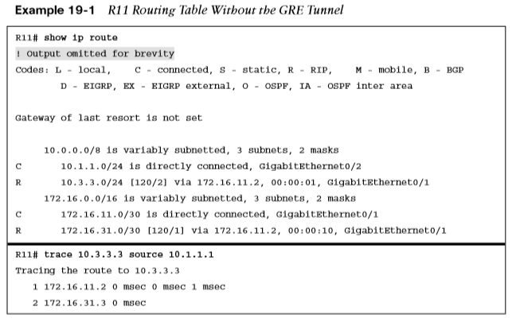
Generic Routing Encapsulation (GRE) Tunnels GRE Tunnel Configuration (Cont.)
Example 19-1 shows the routing table of R11 before the GRE tunnel is created. Notice that the 10.3.3.0/24 network is reachable by RIP and is two hops away.

Slide 7
Generic Routing Encapsulation (GRE) Tunnels GRE Tunnel Configuration (Cont.)
The steps for configuring GRE tunnels are as follows:
Step 1. Create the tunnel interface by using the global configuration command interface tunnel tunnel-number.
Step 2. Identify the local source of the tunnel by using the interface parameter command tunnel source {ip-address | interface-id}.
Step 3. Identify the tunnel destination by using the interface parameter command tunnel destination ip-address.
Step 4. Allocate an IP address to the tunnel interface by using the command ip address ip-address subnet-mask.
Step 5. Optionally define the tunnel bandwidth, measured in kilobits per second, by using the interface parameter command bandwidth [1-10000000].
Step 6. Optionally specify a GRE tunnel keepalive by using the interface parameter command keepalive [seconds [retries]].
Step 7. Optionally define the IP maximum transmission unit (MTU) for the tunnel interface by using the interface parameter command ip mtu mtu.

Slide 8
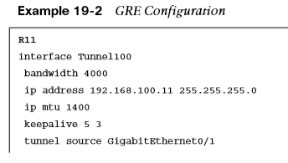
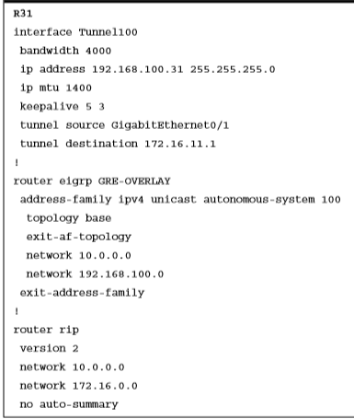
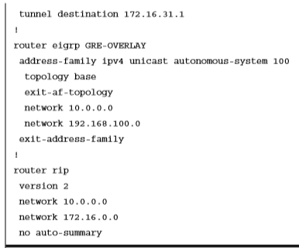
Generic Routing Encapsulation (GRE) Tunnels GRE Sample Configuration
Example 19-2 provides the GRE tunnel configuration for R11 and R31. EIGRP is enabled on the LAN (10.0.0.0/8) and GRE tunnel (192.168.100.0/24) networks. RIP is enabled on the LAN (10.0.0.0/8) and transport (172.16.0.0/16) networks but is not enabled on the GRE tunnel. R11 and R31 become direct EIGRP peers on the GRE tunnel because all the network traffic is encapsulated between them.

Slide 9
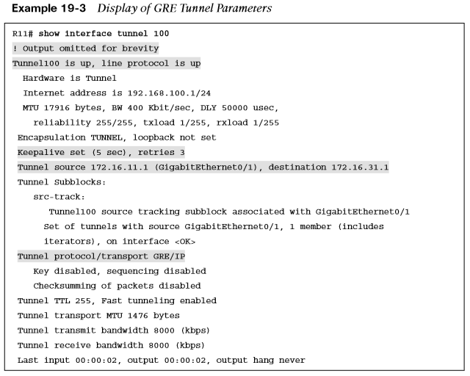
Generic Routing Encapsulation (GRE) Tunnels GRE Sample Configuration (Cont.)
When the GRE tunnel is configured, the state of the tunnel can be verified with the command show interface tunnel number. Example 19-3 displays output from this command.

Slide 10
Next Hop Resolution Protocol (NHRP)
Next Hop Resolution Protocol (NHRP) is defined in RFC 2332 as a method to provide address resolution for hosts or networks (with ARP-like capability) for nonbroadcast multi-access (NBMA) networks such as Frame Relay and ATM networks.
NHRP is a client/server protocol that allows devices to register themselves over directly connected or disparate networks.
DMVPN uses mGRE tunnels and therefore requires a method of mapping tunnel IP addresses to the transport (underlay) IP address. NHRP provides the technology for mapping those IP addresses.

Slide 11
Next Hop Resolution Protocol NHRP Message Types
All NHRP packets must include the source NBMA address, source protocol address, destination protocol address, and NHRP message type. The NHRP message types are explained in Table 19-3.
Message Type | Description
Registration | Registration messages are sent by the NHC (DMVPN spoke) toward the NHS (DMVPN hub). Registration allows the hubs to know a spoke’s NBMA information.
Resolution | Resolution messages are NHRP messages designed to locate and provide the address resolution information of the egress router toward the destination.
Redirect | Redirect messages are an essential component of DMVPN Phase 3. They allow an intermediate router to notify the encapsulator (a router) that a specific network can be reached by using a more optimal path (spoke-to-spoke tunnel).
Purge | Purge messages are sent to remove a cached NHRP entry. Purge messages notify routers of the loss of a route used by NHRP. A purge is typically sent by an NHS to an NHC (which it answered) to indicate that the mapping for an address/network that it answered is not valid anymore.
Error | Error messages are used to notify the sender of an NHRP packet that an error has occurred.

Slide 12
Next Hop Resolution Protocol NHRP Message Extensions
NHRP messages can contain additional information that is included in the extension part of a message. Table 19-4 lists the common NHRP message extensions.
Message Extension | Description
Responder address | This is used to determine the address of the responding node for reply messages.
Forward transit NHS record | This contains a list of NHSs that the NHRP request packet may have traversed.
Reverse transit NHS record | This contains a list of NHSs that the NHRP reply packet may have traversed.
Authentication | This conveys authentication information between NHRP speakers. Authentication is done pairwise on a hop-by-hop basis. This field is transmitted in plaintext.
Vendor private | This conveys vendor private information between NHRP speakers.
NAT | DMVPN works when a hub or spoke resides behind a device that performs NAT and when the tunnel is encapsulated in IPsec.

Slide 13
Dynamic Multipoint VPN (DMVPN)
DMVPN provides complete connectivity while simplifying configuration as new sites are deployed. It is considered a zero-touch technology because no configuration is needed on the DMVPN hub routers as new spokes are added to the DMVPN network.
A spoke site initiates a persistent VPN connection to the hub router. Network traffic between spoke sites does not have to travel through the hubs. DMVPN dynamically builds a VPN tunnel between spoke sites on an as-needed basis.

Slide 14
Dynamic Multipoint VPN (DMVPN) DMVPN Benefits
DMVPN provides the following benefits to network administrators:
Zero-touch provisioning - DMVPN hubs do not require additional configuration when additional spokes are added.
Scalable deployment - Minimal peering and minimal permanent state on spoke routers allow for massive scale.
Spoke-to-spoke tunnels - DMVPN provides full-mesh connectivity while requiring configuration of only the initial spoke-to-hub tunnel.
Flexible network topologies - DMVPN operation does not make any rigid assumptions about either the control plane or data plane overlay topologies.
Multiprotocol support - DMVPN can use IPv4, IPv6, and MPLS as the overlay or transport network protocol.
Multicast support - DMVPN allows multicast traffic to flow on the tunnel interfaces.
Adaptable connectivity - DMVPN routers can establish connectivity behind NAT.
Standardized building blocks - DMVPN uses industry-standardized technologies (NHRP, GRE, and IPsec) to build an overlay network.

Slide 15
Dynamic Multipoint VPN (DMVPN) DMVPN Phases 1, 2, and 3
DMVPN was released in three phases, each phase built on the previous one with additional functions. All three phases of DMVPN need only one tunnel interface on a router, and the DMVPN network size should accommodate all the endpoints associated with that tunnel network.
Phase 1: Spoke-to-Hub – Phase 1 provides a zero-touch deployment for VPN sites. VPN tunnels are created only between spoke and hub sites. Traffic between spokes must traverse the hub to reach any other spoke.
Phase 2: Spoke-to-Spoke – Phase 2 provides additional capability beyond DMVPN Phase 1 and allows spoke-to-spoke communication on a dynamic basis by creating an on-demand VPN tunnel between the spoke devices.
Phase 3: Hierarchical Tree Spoke-to-Spoke - Phase 3 refines spoke-to-spoke connectivity by enhancing the NHRP messaging and interacting with the routing table. With DMVPN Phase 3, the hub sends an NHRP redirect message to the spoke that originated the packet flow. The NHRP redirect message provides the necessary information so that the originator spoke can initiate a resolution of the destination host/network.

Slide 16
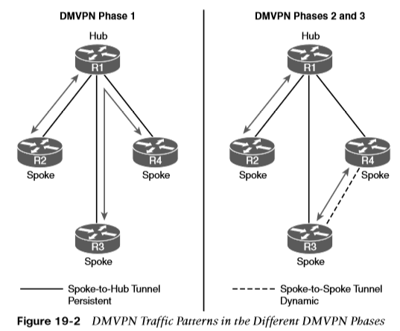
Dynamic Multipoint VPN (DMVPN) DMVPN Phase Comparison
Figure 19-2 illustrates the differences in traffic patterns for the three DMVPN phases. All three models support direct spoke-to-hub communication, as shown by R1 and R2. Spoke-to-spoke packet flow in DMVPN Phase 1 is different from the packet flow in DMVPN Phases 2 and 3. Traffic between R3 and R4 must traverse the hub for Phase 1 DMVPN, whereas a dynamic spoke-to-spoke tunnel is created for DMVPN Phase 2 and Phase 3 that allows direct communication.

Slide 17
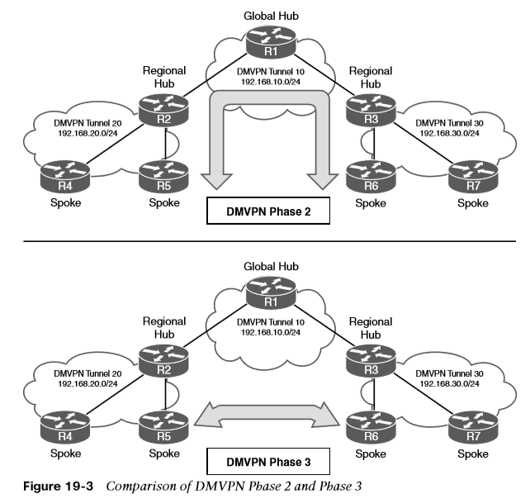
Dynamic Multipoint VPN (DMVPN) DMVPN Phase Comparison (Cont.)
Figure 19-3 illustrates the difference in traffic patterns between Phase 2 and Phase 3 DMVPN with hierarchical topologies (multilevel). In this two-tier hierarchical design, R2 is the hub for DMVPN tunnel 20, and R3 is the hub for DMVPN tunnel 30.
This chapter explains the DMVPN fundamentals with DMVPN Phase 1 and then explains DMVPN Phase 3. It does not cover DMVPN Phase 2.

Slide 18
DMVPN Configuration
There are two types of DMVPN configurations, hub and spoke. Each is used depending on a router’s role. The DMVPN hub is the NHRP NHS, and the DMVPN spoke is the NHRP NHC.
The spokes should be preconfigured with the hub’s static IP address, but a spoke’s NBMA IP address can be static or assigned from DHCP.
In this book, the terms spoke router and branch router are used interchangeably, as are the terms hub router and headquarters/data center router.

Slide 19
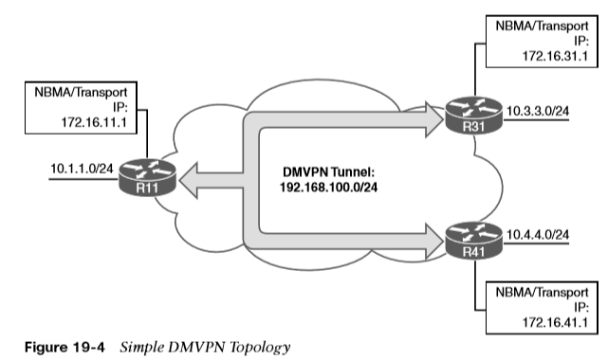
DMVPN Configuration Simple DMVPN Topology
Figure 19-4 shows the first topology used to explain DMVPN configuration and functions. R11 acts as the DMVPN hub, and R31 and R41 are the DMVPN spokes. All three routers use a static default route to the SP router that provides connectivity for the NBMA ( transport) networks in the 172.16.0.0/16 network range. EIGRP has been configured to operate on the DMVPN tunnel and to advertise the local LAN networks.

Slide 20
DMVPN Configuration DMVPN Hub Configuration
The steps for configuring DMVPN on a hub router are as follows:
Step 1. Create the tunnel interface by using the interface tunnel tunnel-number global configuration command.
Step 2. Identify the local source of the tunnel by using the tunnel source {ip-address | interface-id} interface parameter command.
Step 3. Configure the DMVPN tunnel as an mGRE tunnel by using the tunnel mode gre multipoint interface parameter command.
Step 4. Allocate an IP address for the DMVPN network (tunnel) by using the ip address ip-address subnet-mask command.
Step 5. Enable NHRP on the tunnel interface and uniquely identify the DMVPN tunnel for the virtual interface by using the ip nhrp network-id 1-4294967295 interface parameter command.
Step 6. Optionally define the tunnel key, which adds 4 bytes to the DMVPN header, with the tunnel key 0 -4294967295 command.
Step 7. Optionally enable multicast support for NHRP on DMVPN hub routers by using the ip nhrp map multicast dynamic tunnel command.

Slide 21
DMVPN Configuration DMVPN Hub Configuration (Cont.)
The steps for configuring DMVPN on a hub router are as follows:
Step 8. For Phase 3, enable NHRP redirect functions by using the ip nhrp redirect command.
Step 9. Optionally define the tunnel bandwidth, measured in kilobits per second, by using the bandwidth [1-10000000] interface parameter command.
Step 10. Optionally configure the IP MTU for the tunnel interface by using the ip mtu mtu interface parameter command.
Step 11. Optionally define the TCP maximum segment size (MSS) by using the ip tcp adjust-mss mss-size command.
Note: mGRE tunnels do not support the option for using a keepalive.

Slide 22
DMVPN Configuration DMVPN Spoke Configuration for DMVPN Phase 1 (Point-to-Point
Configuration of DMVPN Phase 1 spokes is similar to the configuration for a hub router except in two ways:
It does not use an mGRE tunnel. Instead, the tunnel destination is specified.
The NHRP mapping points to at least one active NHS.
The process for configuring a DMVPN Phase 1 spoke router is as follows:
Step 1. Create the tunnel interface by using the interface tunnel tunnel-number global configuration command.
Step 2. Identify the local source of the tunnel by using the tunnel source {ip-address | interface-id} interface parameter command.
Step 3. Identify the tunnel destination by using the tunnel destination ip-address interface parameter command.
Step 4. Allocate an IP address for the DMVPN network (tunnel) by using the ip address {ip-address subnet-mask | dhcp} command or the ipv6 address ipv6-address/prefix-length command.
Step 5. Enable NHRP on the tunnel interface and uniquely identify the DMVPN tunnel for the virtual interface by using the ip nhrp network-id 1-4294967295 interface parameter command.

Slide 23
DMVPN Configuration DMVPN Spoke Configuration for DMVPN Phase 1 (Point-to-Point) (Cont.)
The process for configuring a DMVPN Phase 1 spoke router is as follows:
Step 6. Optionally define the NHRP tunnel key, which adds 4 bytes to the DMVPN header, by using the tunnel key 0-4294967295 command.
Note: If the tunnel key is defined on the hub router, it must be defined on all the spoke routers.
Step 7. Specify the address of one or more NHRP NHSs by using the ip nhrp nhs nhs-address nbma nbma-address [multicast] command.
Note: Remember that the NBMA address is the transport IP address, and the NHS address is the protocol address for the DMVPN hub.
Step 8. Optionally define the tunnel bandwidth, measured in kilobits per second, by using the bandwidth [1-10000000] interface parameter command.
Step 9. Optionally define the IP MTU for the tunnel interface by using the ip mtu mtu interface parameter command.
Step 10. Optionally define the TCP MSS by using the ip tcp adjust-mss mss-size command.

Slide 24
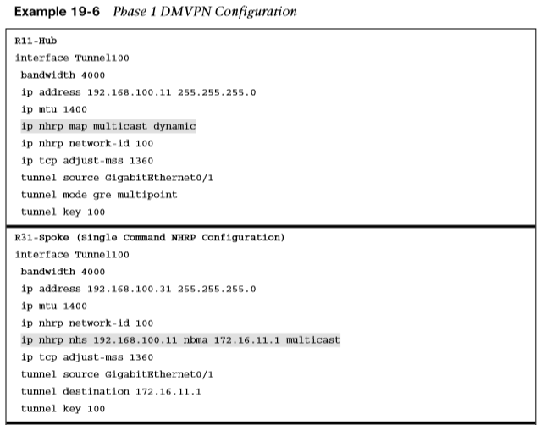
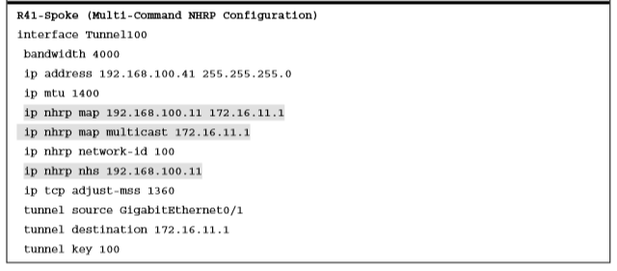
DMVPN Configuration DMVPN Spoke Configuration for DMVPN Phase 1 (Point-to-Point) (Cont.)
Example 19-6 provides a sample configuration for R11 (hub), R31 (spoke), and R41 (spoke).

Slide 25
DMVPN Configuration Viewing DMVPN Tunnel Status
The show dmvpn [detail] command provides the tunnel interface, tunnel role, tunnel state, and tunnel peers with uptime. When the DMVPN tunnel interface is administratively shut down, there are no entries associated with that tunnel interface. These are the tunnel states, in order of establishment:
INTF – The line protocol of the DMVPN tunnel is down.
IKE – DMVPN tunnels configured with IPsec have not yet successfully established an Internet Key Exchange (IKE) session.
IPsec - An IKE session has been established, but an IPsec security association (SA) has not yet been established.
NHRP - The DMVPN spoke router has not yet successfully registered.
Up - The DMVPN spoke router has registered with the DMVPN hub and received an ACK (positive registration reply) from the hub.

Slide 26
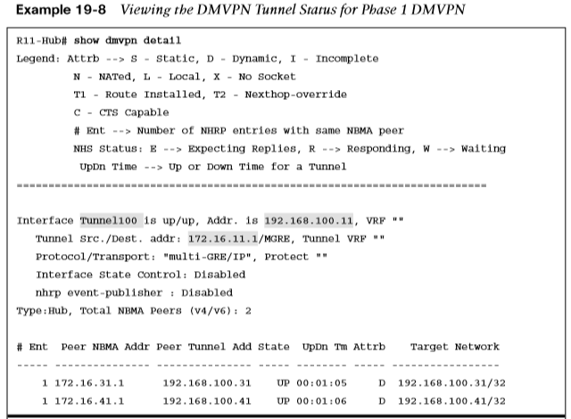
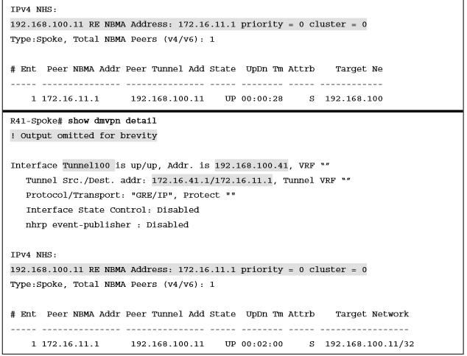
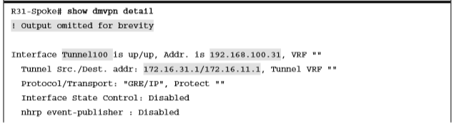
DMVPN Configuration Viewing DMVPN Tunnel Status (Cont.)
Example 19-8 provides output of the show dmvpn detail command. The detail keyword provides the local tunnel and NBMA IP addresses, tunnel health monitoring, and VRF contexts.

Slide 27
DMVPN Configuration Viewing the NHRP Cache
Every router maintains a cache of requests that it receives or is processing. The NHRP cache contains the following fields displayed using the show ip nhrp [brief] :
Network entry for hosts or for a network/xx and the tunnel IP address to NBMA IP address.
The interface number, duration of existence, and expiration (hours:minutes:seconds).
The NHRP mapping entry type. Table 19-6 provides a list of NHRP mapping entries in the local cache.
NHRP Mapping Entry | Description
static | An entry created statically on a DMVPN interface.
dynamic | An entry created dynamically. DMVPN Phase 1: an entry created from a spoke that registered with an NHS with an NHRP registration request.
incomplete | A temporary entry placed locally while an NHRP resolution request processes. Incomplete entries prevent repetitive NHRP requests for the same entry, avoiding unnecessary consumption of router resources.
local | Displays local mapping info. Represents a local network that was advertised for an NHRP resolution reply.
(no-socket) | Mapping entries that do not have associated IPsec sockets and where encryption is not triggered.
NBMA address | Nonbroadcast multi-access address, or the transport IP address where the entry was received.

Slide 28
DMVPN Configuration Viewing the NHRP Cache (Cont.)
NHRP message flags specify attributes of an NHRP cache entry or of the peer for which the entry was created. Table 19-7 provides a list of the NHRP message flags and their meanings.
NHRP Message Flag | Description
Used | Indication that this NHRP mapping entry was used to forward data packets within the past 60 seconds.
Implicit | Indicates that the NHRP mapping entry was learned implicitly.
Unique | Indicates that this NHRP mapping entry must be unique and that it cannot be overwritten with a mapping entry that has the same tunnel IP address but a different NBMA address.
Router | Indicates that this NHRP mapping entry is from a remote router that provides access to a network or host that is located behind the remote router.
Rib | Indicates that this NHRP mapping entry has a corresponding routing entry in the routing table.
Nho | Indicates that this NHRP mapping entry has a corresponding path that overrides the next hop for a remote network, as installed by another routing protocol.
Nhop | Indicates an NHRP mapping entry for a remote next-hop address and its associated NBMA address.

Slide 29
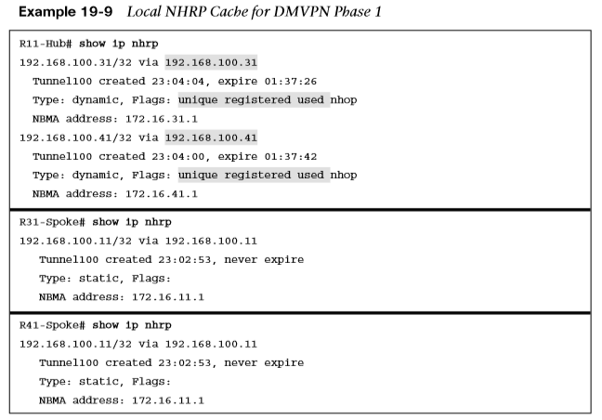
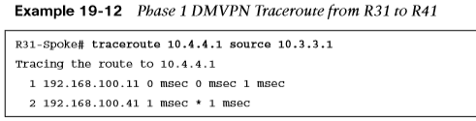
DMVPN Configuration Viewing the NHRP Cache (Cont.)
Example 19-9 shows the local NHRP cache for the various routers in the sample topology.
The traceroute shown in Example 19-12 verifies that R31 can connect to R41, but network traffic must still pass through R11.

Slide 30
DMVPN Configuration DMVPN Configuration for Phase 3 DMVPN (Multipoint)
The Phase 3 DMVPN configuration for the hub router adds the ip nhrp redirect interface parameter command on the hub router. This command checks the flow of packets on the tunnel interface and sends a redirect message to the source spoke router when it detects packets hairpinning out of the DMVPN cloud. Hairpinning means that traffic is received and sent out an interface in the same cloud (identified by the NHRP network ID). The steps for configuring a DMVPN Phase 3 spoke router are as follows:
Step 1. Create the tunnel interface by using the interface tunnel tunnel-number global configuration command.
Step 2. Identify the local source of the tunnel by using the tunnel source {ip-address | interface-id} interface parameter command.
Step 3. Configure the DMVPN tunnel as a GRE multipoint tunnel by using the tunnel mode gre multipoint interface parameter command.
Step 4. Allocate an IP address for the DMVPN network (tunnel) by using the ip address ip-address subnet-mask command.
Step 5. Enable NHRP and uniquely identify the DMVPN tunnel for the virtual interface by using the ip nhrp network-id 1-4294967295 interface parameter command.
Step 6. Optionally configure the tunnel key by using the tunnel key 0-4294967295 command.
Step 7. Enable the NHRP shortcut function by using the ip nhrp shortcut command.

Slide 31
DMVPN Configuration DMVPN Configuration for Phase 3 DMVPN (Multipoint) (Cont.)
The steps for configuring a DMVPN Phase 3 spoke router are as follows:
Step 8. Specify the address of one or more NHRP NHSs by using the ip nhrp nhs nhs-address nbma nbma-address [multicast] command.
Step 9. Optionally define the IP MTU for the tunnel interface by using the ip mtu mtu interface parameter command.
Step 10. Optionally define the TCP MSS feature, which ensures that the router will edit the payload of a TCP three-way handshake if the MSS exceeds the configured value. The command is ip tcp adjust-mss mss-size.

Slide 32
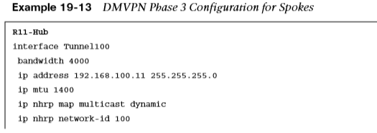
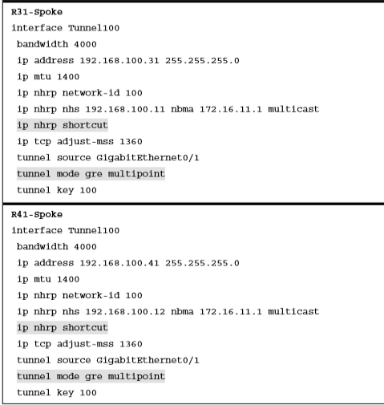
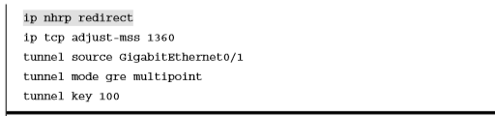
DMVPN Configuration DMVPN Configuration for Phase 3 DMVPN (Multipoint) (Cont.)
Example 19-13 provides a sample configuration for R11 (hub), R21 (spoke), and R31 (spoke) configured with Phase 3 DMVPN.

Slide 33
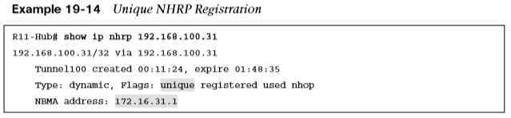
DMVPN Configuration IP NHRP Authentication and Unique IP NHRP Registration
NHRP authentication is weak because the password is stored in plaintext. Enable NHRP authentication by using the ip nhrp authentication password interface parameter command.
When an NHC registers with an NHS, it provides the protocol address and the NBMA address. The NHS maintains a local cache of these settings. This capability is indicated by the NHRP message flag unique on the NHS, as shown in Example 19-14.

Slide 34
Spoke-to-Spoke Communication
This section focuses on the underlying mechanisms used to establish spoke-to-spoke communication.
In DMVPN Phase 1, the spoke devices rely on the configured tunnel destination to identify where to send the encapsulated packets.
Phase 3 DMVPN uses mGRE tunnels and thereby relies on NHRP redirect and resolution request messages to identify the NBMA addresses for any destination networks.

Slide 35
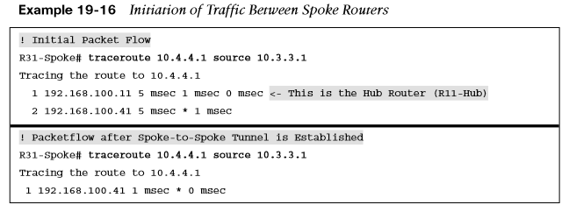
Spoke-to-Spoke Communication Spoke-to-Spoke Communication
Packets flow through the hub in a traditional hub-and-spoke manner until the spoke-to-spoke tunnel has been established in both directions. As packets flow across the hub, the hub engages NHRP redirection to begin finding a more optimal path with spoke-to-spoke tunnels. In Example 19-16, R31 initiates a traceroute to R41. Notice that the first packet travels across R11 (hub), but by the time a second stream of packets is sent, the spoke-to-spoke tunnel has been initialized so that traffic flows directly between R31 and R41 on the transport and overlay networks.

Slide 36
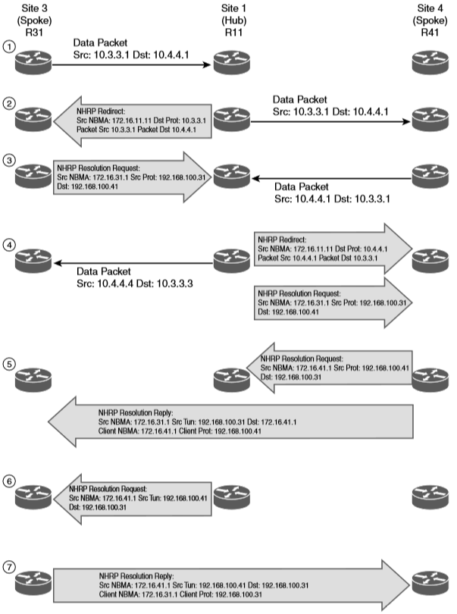
Spoke-to-Spoke Communication Forming Spoke-to-Spoke Tunnels
This section explains in detail how a spoke-to-spoke DMVPN tunnel is formed. Figure 19-5 illustrates the packet flow among all three devices—R11, R31, and R41—to establish a bidirectional spoke-to-spoke DMVPN tunnel.

Slide 37
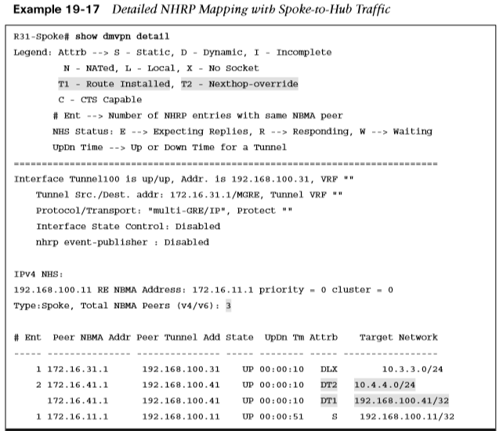

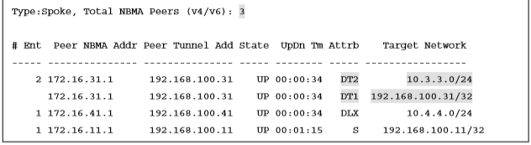
Spoke-to-Spoke Communication Forming Spoke-to-Spoke Tunnels (Cont.)
Example 19-17 shows the status of DMVPN tunnels on R31 and R41, where there are two new spoke-to-spoke tunnels (highlighted). The DLX entries represent the local (no-socket) routes. The original tunnel to R11 remains a static tunnel.

Slide 38
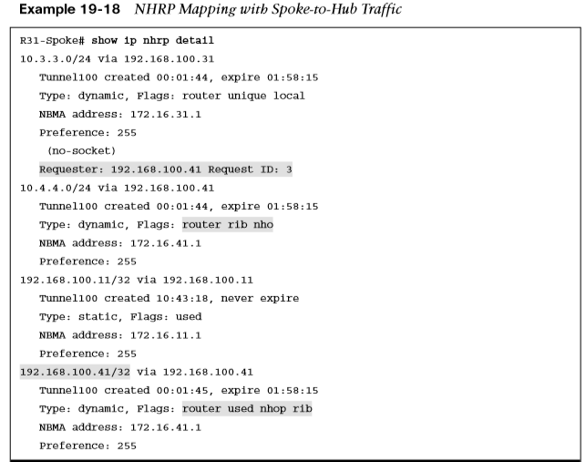

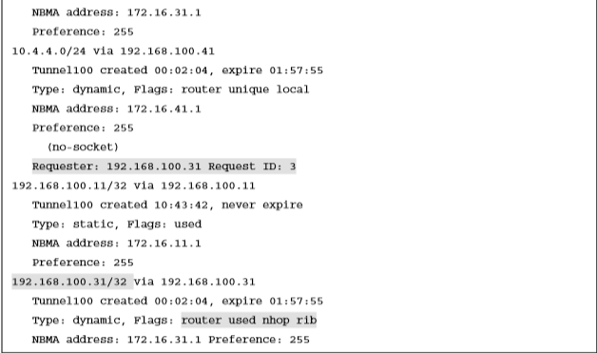
Spoke-to-Spoke Communication Forming Spoke-to-Spoke Tunnels (Cont.)
Example 19-18 shows the NHRP cache for R31 and R41. Notice the NHRP mappings: router, rib, nho, and nhop.

Slide 39
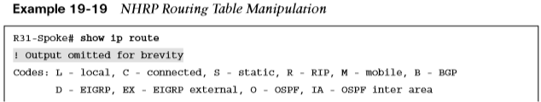
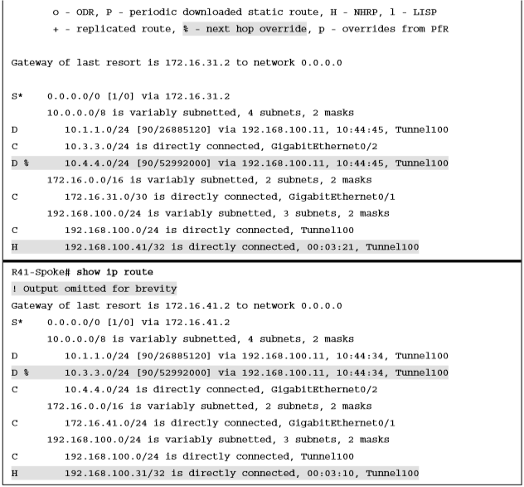
Spoke-to-Spoke Communication NHRP Routing Table Manipulation
NHRP interacts with the routing/forwarding tables and installs or modifies routes in the routing table. In the event that an entry exists with an exact match for the network and prefix length, NHRP overrides the existing next hop with a shortcut. The original protocol is still responsible for the prefix, but overwritten next-hop addresses are indicated in the routing table by the percent sign (%).
Example 19-19 provides the routing tables for R31 and R41.

Slide 40
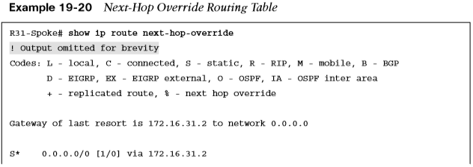
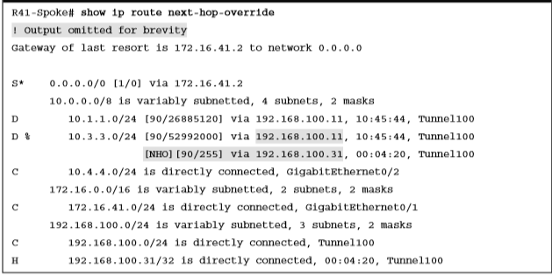
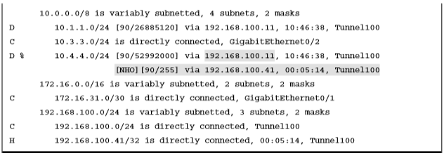
Spoke-to-Spoke Communication NHRP Routing Table Manipulation (Cont.)
The command show ip route next-hop-override displays the routing table with the explicit NHRP shortcuts that were added. Example 19-20 shows the command’s output for the sample topology. Notice that the NHRP shortcut is indicated by the NHO marking and shown underneath the original entry with the correct next-hop IP address.

Slide 41
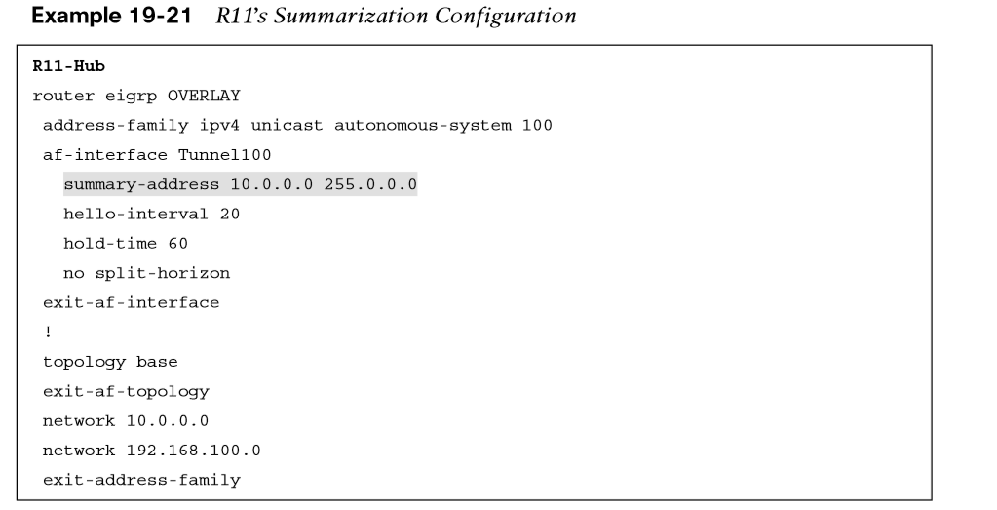
Spoke-to-Spoke Communication NHRP Routing Table Manipulation with Summarization
Summarizing routes on WAN links provides stability by hiding network convergence and thereby adding scalability. This section demonstrates NHRP’s interaction on the routing table when the exact route does not exist there. R11’s EIGRP configuration now advertises the 10.0.0.0/8 summary prefix out tunnel 100. The spoke routers use the summary route for forwarding traffic until the NHRP establishes the spoke-to-spoke tunnel. The more explicit entries from NHRP are installed into the routing table after the spoke-to-spoke tunnels have been initialized.
Example 19-21 shows the change to R11’s EIGRP configuration for summarizing the 10.0.0.0/8 networks out the tunnel 100 interface.

Slide 42
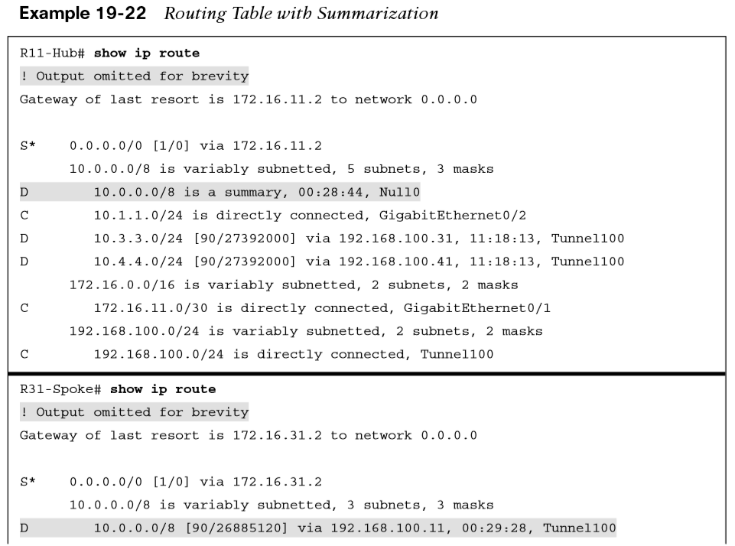
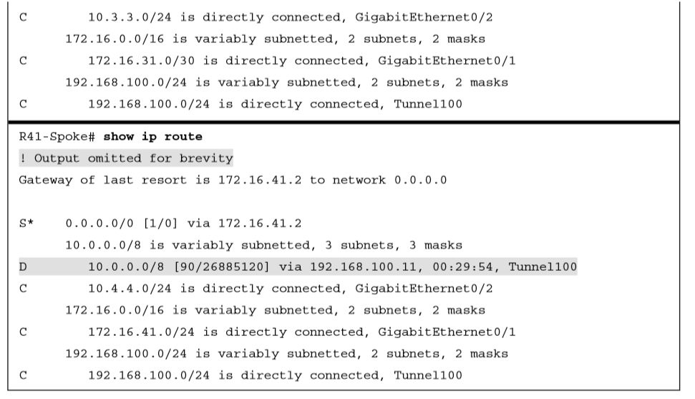
Spoke-to-Spoke Communication NHRP Routing Table Manipulation with Summarization (Cont.)
You can clear the NHRP cache on all routers by using the command clear ip nhrp, which removes any NHRP entries.
Example 19-22 shows the routing tables for R11, R31, and R41. Notice that only the 10.0.0.0/8 summary route provides initial connectivity among all three routers.

Slide 43
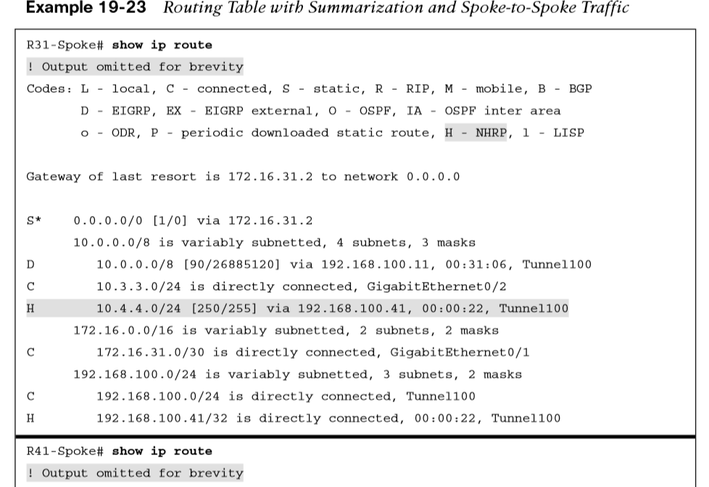
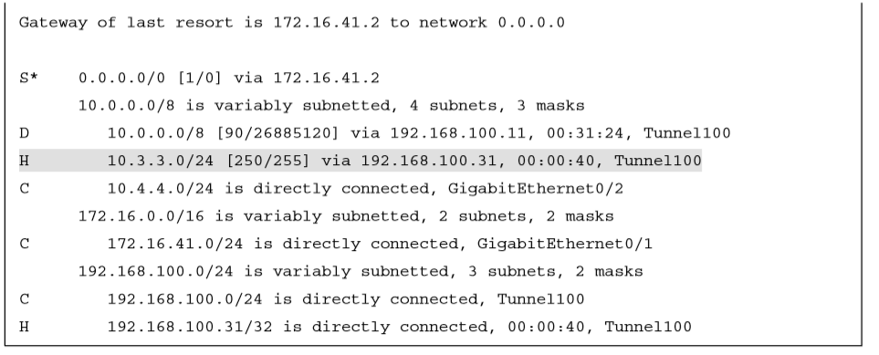
Spoke-to-Spoke Communication NHRP Routing Table Manipulation with Summarization (Cont.)
Traffic was re-initiated from 10.3.3.1 to 10.4.4.1 to initialize the spoke-to-spoke tunnels. R11 still sends the NHRP redirect for hairpinned traffic, and the pattern would complete as shown earlier except that NHRP would install a more specific route into the routing table on R31 (10.4.4.0/24) and R41 (10.3.3.0/24). The NHRP injected route is indicated by the H entry, as shown in Example 19-23.

Slide 44
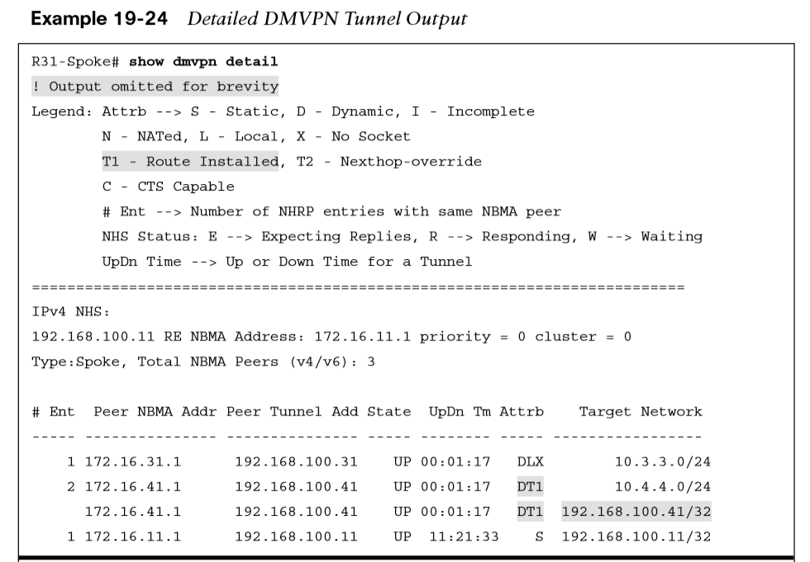
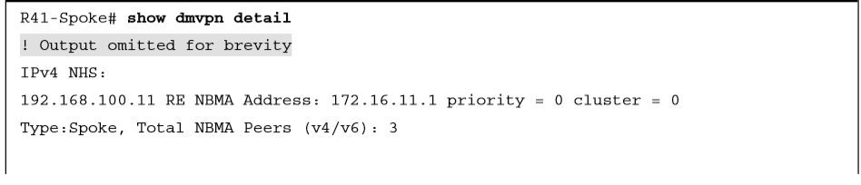
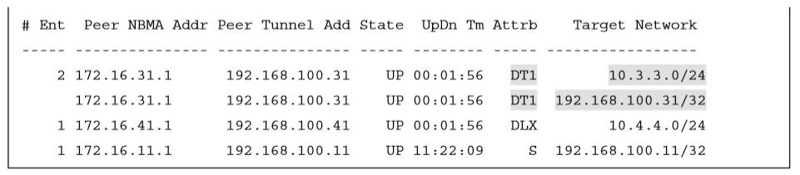
Spoke-to-Spoke Communication NHRP Routing Table Manipulation with Summarization (Cont.)
Example 19-24 shows the DMVPN tunnels after R31 and R41 have initialized the spoke-to-spoke tunnel with summarization on R11. Notice that both of the new spoke-to-spoke tunnel entries are DT1 because they are new routes in the RIB. If the routes had been more explicit (as shown in Example 19-19), NHRP would have overridden the next-hop address and used a DT2 entry.

Slide 45
Problems with Overlay Networks
Two problems are frequently found with tunnel or overlay networks: recursive routing and outbound interface selection.
The following sections explain these problems and describe solutions to them.

Slide 46
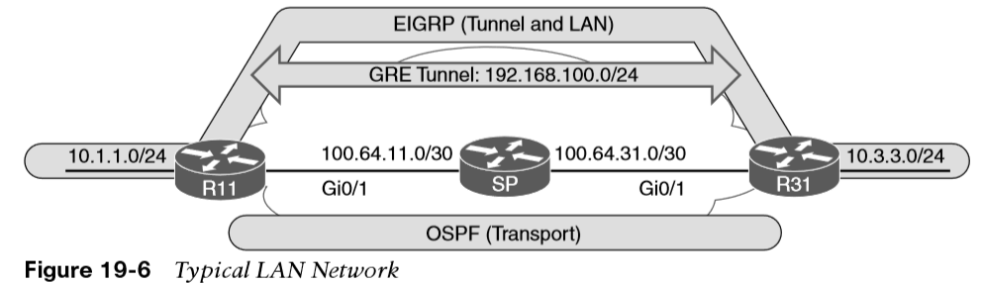
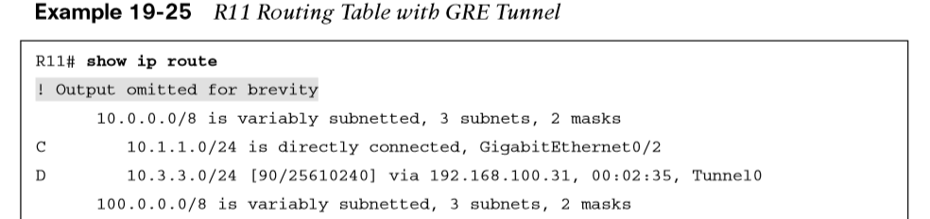
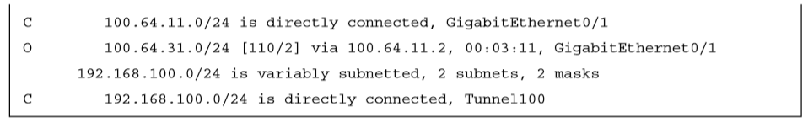
Problems with Overlay Networks Recursive Routing Problems
If a router tries to reach the remote router’s encapsulating interface (transport IP address) through the tunnel (overlay network), problems will occur. This is a common issue when a transport network is advertised into the same routing protocol that runs on the overlay network.
Figure 19-6 demonstrates a simple GRE tunnel between R11 and R31. R11, R31, and the SP routers are running OSPF on the 100.64.0.0/16 transport networks. R11 and R31 are running EIGRP on the 10.0.0.0/8 LAN and 192.168.100.0/24 tunnel network.
Example 19-25 shows R11’s routing table, with everything working properly.

Slide 47
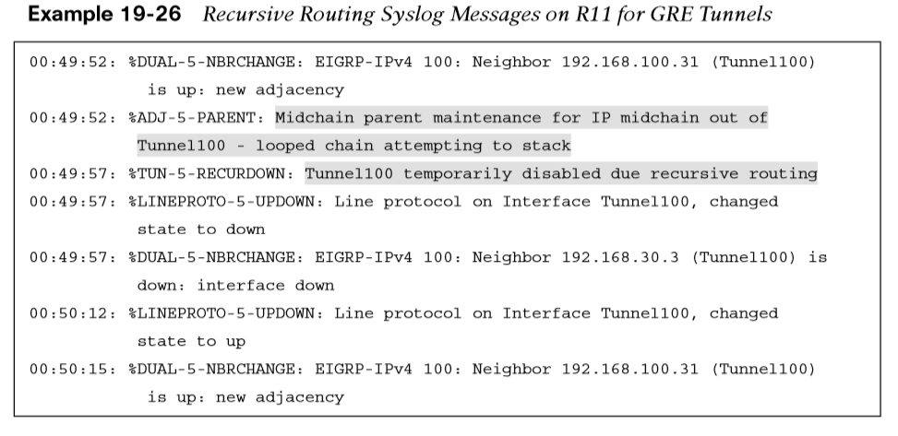
Problems with Overlay Networks Recursive Routing Problems (Cont.)
An administrator has accidentally added the 100.64.0.0/16 network interfaces to EIGRP on R11 and R31. The SP router is not running EIGRP, so an adjacency does not form, but R11 and R31 add the transport network to EIGRP, which has a lower AD than OSPF. The routers then try to use the tunnel to reach the tunnel endpoint address, which is not possible. This scenario is known as recursive routing.
The router detects recursive routing and provides an appropriate syslog message, as shown in Example 19-26. The tunnel is brought down, which terminates the EIGRP neighbors, and then R11 and R31 find each other again by using OSPF. The tunnel is reestablished, EIGRP forms a relationship, and the problem repeats over and over again.
Only point-to-point GRE tunnels provide the syslog message “temporarily disabled due to recursive routing.” Both DMVPN and GRE tunnels use the message “looped chained attempting to stack.”

Slide 48
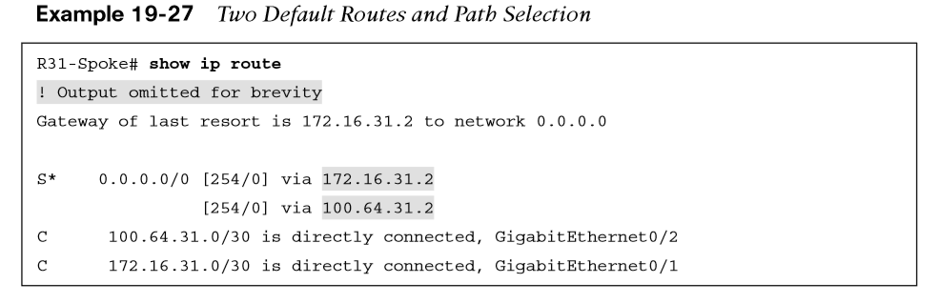
Problems with Overlay Networks Outbound Interface Selection
In certain scenarios, it is difficult for a router to properly identify the outbound interface for encapsulating packets for a tunnel. Typically a branch site uses multiple transports (one DMVPN tunnel per transport) for network resiliency. Imagine that R31 is connected to two different Internet service providers that receive their IP addresses from DHCP. R31 would have only two default routes for providing connectivity to the transport networks, as shown in Example 19-27.

Slide 49
Problems with Overlay Networks Front Door Virtual Routing and Forwarding
Virtual routing and forwarding (VRF) contexts create unique logical routers on a physical router so that router interfaces, routing tables, and forwarding tables are completely isolated from other VRF instances.
The routing table of one transport network is isolated from the routing table of the other transport network and that the routing table of the LAN interfaces is separate from those of all the transport networks.
DMVPN tunnels are VRF aware in the sense that the tunnel source or destination can be associated to a different VRF instance from the DMVPN tunnel itself.
Using an FVRF instance for every DMVPN tunnel prevents route recursion because the transport and overlay networks remain in separate routing tables.
VRF instances are locally significant, but the configuration/naming should be consistent to simplify the operational aspects.

Slide 50
Problems with Overlay Networks Configuring Front Door VRF (FVRF)
The following steps are required to create an FVRF instance, assign it to the transport interface, and make the DMVPN tunnel aware of the FRF instance:
Step 1. Create the FVRF instance by using the vrf definition vrf-name command.
Step 2. Initialize the appropriate address family for the transport network by using the command address-family {ipv4 | ipv6}. The address family can be IPv4, IPv6, or both.
Step 3. Enter interface configuration submode and specify the interface to be associated with the VRF instance by using the command interface interface-id. The VRF instance is linked to the interface with the interface parameter command vrf forwarding vrf-name.
Step 4. Configure an IPv4 address by using the command ip address ip-address subnet-mask or an IPv6 address by using the command ipv6 address ipv6-address/prefix-length.
Step 5. Associate the FVRF instance with the DMVPN tunnel by using the interface parameter command tunnel vrf vrf-name on the DMVPN tunnel.
If an IP address is already configured on the interface, when the VRF instance is linked to the interface, the IP address is removed from that interface.

Slide 51
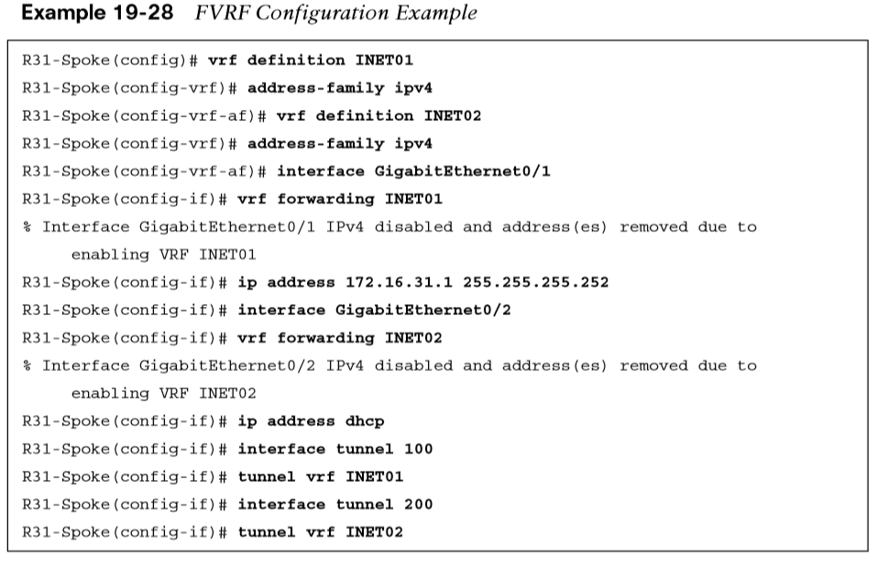
Problems with Overlay Networks Configuring Front Door VRF (FVRF) (Cont.)
Example 19-28 shows how the FVRF instances named INET01 and INET02 are created on R31. Notice that when the FVRF instances are associated, the IP addresses are removed from the interfaces. The IP addresses are reconfigured and the FVRF instances are associated with the DMVPN tunnels.

Slide 52
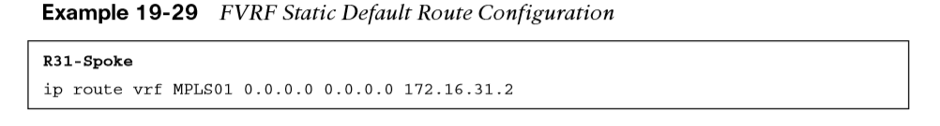
Problems with Overlay Networks FVRF Static Routes
FVRF interfaces that are assigned an IP address by DHCP automatically install a default route with an AD of 254. FVRF interfaces with static IP addressing require only a static default route in the FVRF context. This is accomplished with the command ip route vrf vrf-name 0.0.0.0 0.0.0.0 next-hop-ip. Example 19-29 shows the configuration for R31 for the INET01 FVRF instance. The INET02 FVRF instance does not need a static default route because it gets the route from the DHCP server.

Slide 53
DMVPN Failure Detection and High Availability
An NHRP mapping entry stays in the NHRP cache for a finite amount of time. The entry is valid based on the NHRP holdtime period, which defaults to 7200 seconds (2 hours).
The NHRP holdtime can be modified with the interface parameter command ip nhrp holdtime 1-65535 and should be changed to the recommended value of 600 seconds.
A secondary function of the NHRP registration packets is to verify that connectivity is maintained to the NHSs (hubs). NHRP registration messages are sent every NHRP timeout period, and if the NHRP registration reply is not received for a request, the NHRP registration request is sent again with the first packet delayed for 1 second, the second packet delayed for 2 seconds, and the third packet delayed for 4 seconds. The NHS is declared down if the NHRP registration reply has not been received after the third retry attempt.

Slide 54
DMVPN Failure Detection and High Availability DMVPN Failure Detection and High Availability
The spoke-to-hub registration is taken down and displays as NHRP for the tunnel state when examined with the show dmvpn command. The actual tunnel interface still has a line protocol state of up.
During normal operation of the spoke-to-hub tunnels, the spoke continues to send periodic NHRP registration requests, refreshing the NHRP timeout entry and keeping the spoke-to-hub tunnel up. However, in spoke-to-spoke tunnels, if a tunnel is still being used within 2 minutes of the expiration time, an NHRP request refreshes the NHRP timeout entry and keeps the tunnel. If the tunnel is not being used, it is torn down.
The NHRP timeout period defaults to one-third of the NHRP holdtime, which equates to 2400 seconds (40 minutes). The NHRP timeout period can be modified using the interface parameter command ip nhrp registration timeout 1-65535.
When an NHS is declared down, NHCs still attempt to register with the down NHS. This is known as the probe state. The delay between retry packets increments between iterations and uses the following delay pattern: 1, 2, 4, 8, 16, 32, and 64 seconds. The delay never exceeds 64 seconds, and after a registration reply is received, the NHS (hub) is declared up again.

Slide 55
DMVPN Failure Detection and High Availability DMVPN Hub Redundancy
Connectivity from a DMVPN spoke to a hub is essential to maintain connectivity.
If the hub fails, or if a spoke loses connectivity to a hub, that DMVPN tunnel loses its ability to transport packets.
Deploying multiple DMVPN hubs for the same DMVPN tunnel provides redundancy and eliminates a single point of failure.
Additional DMVPN hubs are added simply by adding NHRP mapping commands to the tunnel interface.
All active DMVPN hubs participate in the routing domain for exchanging routes. DMVPN spoke routers maintain multiple NHRP entries (one per DMVPN hub). No additional configuration is required on the hubs.

Slide 56
IPv6 DMVPN Configuration
DMVPN uses GRE tunnels and is capable of tunneling multiple protocols. Enhancements to NHRP added support for IPv6 so that mGRE tunnels can find the appropriate IPv6 addresses.
This means that DMVPN supports the use of IPv4 and IPv6 as the tunnel protocol or the transport protocol in the combination required.

Slide 57
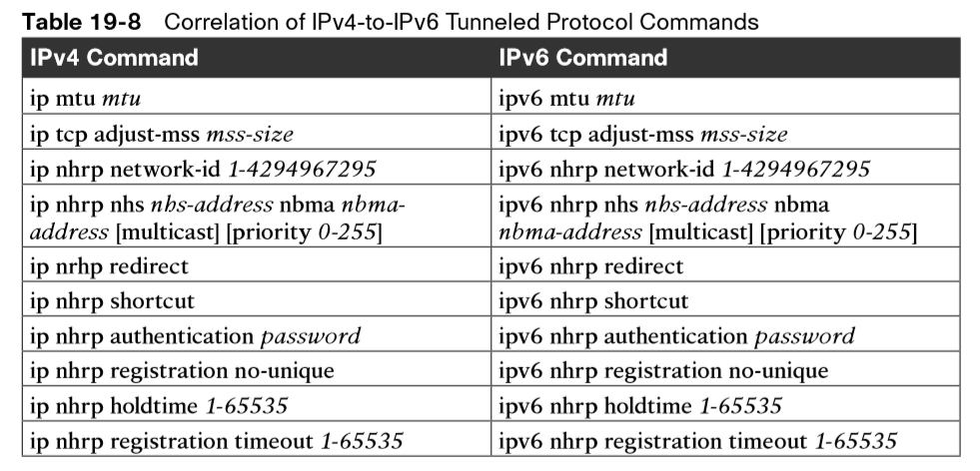
IPv6 DMVPN Configuration IPv6 DMVPN Configuration Commands
For all the commands explained earlier for IPv4, there are equivalent commands to support IPv6. Table 19-8 provides a list of the tunneled protocol commands for IPv4 and the equivalent commands for IPv6.

Slide 58
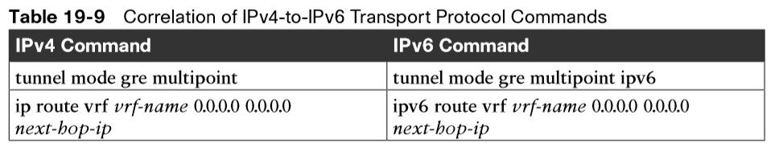
IPv6 DMVPN Configuration IPv6 DMVPN Configuration Commands (Cont.)
Table 19-9 provides a list of the configuration commands that are needed to support an IPv6 transport network. Any tunnel commands not listed in Table 19-9 are transport agnostic and are used regardless of the transport IP protocol version.

Slide 59
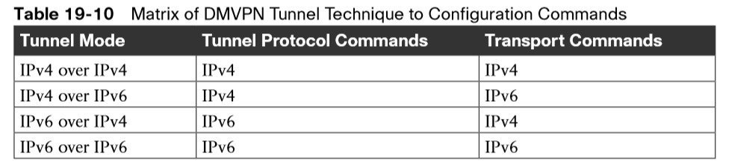
IPv6 DMVPN Configuration IPv6 DMVPN Configuration Commands (Cont.)
IPv6 over DMVPN can be interpreted differently depending on the perspective. There are three possible interpretations:
IPv4 over IPv6: IPv4 is the tunneled protocol over an IPv6 transport network.
IPv6 over IPv6: IPv6 is the tunneled protocol over an IPv6 transport network.
IPv6 over IPv4: IPv6 is the tunneled protocol over an IPv4 transport network.
Regardless of the interpretation, DMVPN supports the IPv4 or IPv6 protocol as the tunneled protocol or the transport, but choosing the correct set of command groups is vital and should be based on the tunneling technique selected.
Table 19-10 provides a matrix to help you select the appropriate commands from Table 19-8 and Table 19-9. It is important to note that nhs-address or NBMA-address in Table 19-8 can be IPv4 or IPv6 addresses.

Slide 60
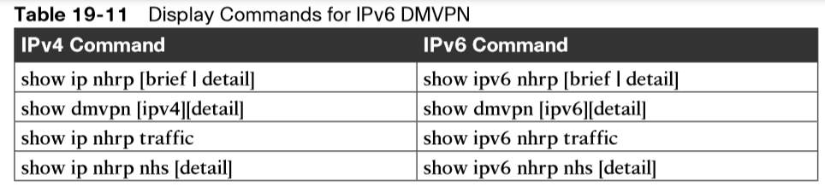
IPv6 DMVPN Configuration IPv6 DMVPN Configuration Commands (Cont.)
Table 19-11 provides a list of IPv4 display commands correlated to the IPv6 equivalents.

Slide 61


IPv6 DMVPN Configuration IPv6-over-IPv6 Sample Configuration
This section provides a sample configuration using the topology from Figure 19-4 for the IPv6-over-IPv6 topology. To simplify the IPv6 addressing scheme, the first two hextets of the book’s IPv6 addresses use 2001:db8 (the RFC-defined address space for IPv6 documentation). After the first two hextets, an IPv4 octet number is copied into an IPv6 hextet, so the IPv6 addresses should look familiar.
Table 19-12 provides an example of how the book converts existing IPv4 addresses and networks to IPv6 format.

Slide 62

IPv6 DMVPN Configuration IPv6-over-IPv6 Sample Configuration
Example 19-30 provides the IPv6-over-IPv6 DMVPN configuration for hub router R11. The VRF definition uses the address-family ipv6 command, and the GRE tunnel is defined with the command tunnel mode gre multipoint ipv6. Notice that the tunnel interface has a regular IPv6 address configured as well as a link-local IPv6 address.

Slide 63


IPv6 DMVPN Configuration IPv6 DMVPN Verification
The show dmvpn [detail] command can be used for viewing any DMVPN tunnel, regardless of the tunnel or transport protocol. The data is structured slightly differently because of the IPv6 address format, but it still provides the same information as before.
Example 19-32 shows the DMVPN tunnel state from R31 after it has established its static tunnels to the DMVPN hubs. Notice that the protocol transport now shows IPv6, and the NHS devices are using IPv6 addresses.

Slide 64

IPv6 DMVPN Configuration IPv6 DMVPN Verification (Cont.)
Example 19-33 demonstrates the connectivity between R31 and R41 before and after the spoke-to-spoke DMVPN tunnel is established.

Slide 65
Prepare for the Exam

Slide 66
Prepare for the Exam Key Topics for Chapter 19
Description
Generic Routing Encapsulation (GRE) tunnels | Phase 1 DMVPN spoke configuration
GRE tunnel configuration | Alternative NHRP mapping commands
Next Hop Resolution Protocol (NHRP) | Viewing DMVPN tunnel status
NHRP message types | Phase 3 DMVPN spoke configuration
Dynamic Multipoint VPN (DMVPN) | IP NHRP authentication
Phase 1 DMVPN | Unique IP NHRP registration
Phase 3 DMVPN | Forming spoke-to-spoke DMVPN tunnels
DMVPN hub configuration | NHRP routing table manipulation

Slide 67
Prepare for the Exam Key Topics for Chapter 19 (Cont.)
Description
NHRP route table manipulation with summarization | DMVPN failure detection and high availability
Recursive routing problems | DMVPN hub redundancy
Outbound interface selection | IPv6 DMVPN configuration
Front door virtual routing and forwarding (FVRF)

Slide 68
Prepare for the Exam Key Terms for Chapter 19
Term
Dynamic Multipoint Virtual Private Network (DMVPN) | GRE tunnel
DMVPN Phase 1 | Next Hop Resolution Protocol (NHRP)
DMVPN Phase 3 | NHRP redirect
encapsulating interface | NHRP shortcut
front door VRF | next-hop server (NHS, recursive routing)

Slide 69
Prepare for the Exam Command Reference for Chapter 19
Task | Command Syntax
Specify the source IP address or interface used for encapsulating packets for a tunnel | tunnel source {ip-address | interface-id}
Specify the destination IP address for establishing a tunnel | tunnel destination ip-address
Convert a GRE tunnel into an mGRE tunnel | tunnel mode gre multipoint
Enable NRHP and uniquely identify a DMVPN tunnel locally | ip nhrp network-id 1-4294967295
Define a tunnel key globally on a DMVPN tunnel interface to allow routers to identify when multiple tunnels use the same encapsulating interface | tunnel key 0-4294967295
Enable plaintext NHRP authentication | ip nhrp authentication password
Associate a front door VRF instance to a DMVPN tunnel interface | tunnel vrf vrf-name

Slide 70
Prepare for the Exam Command Reference for Chapter 19 (Cont.)
Task | Command Syntax
Allow for an NHRP client to register with a different IP address before timing out at the hub | ip nhrp registration no-unique
Enable the NHRP redirect function on a DMVPN hub tunnel interface | ip nhrp redirect
Enable the ability to install NHRP shortcuts into a spoke router’s RIB | ip nhrp shortcut
Enable the mapping of multicast on a DMVPN hub tunnel interface | ip nhrp map multicast dynamic
Specify the NHRP NHS, NBMA address, and multicast mapping on a spoke | ip nhrp nhs nhs-address nbma nbma-address [multicast] Or ip nhrp nhs nhs-address ip nhrp map ip nhrp map multicast [nbma-address | dynamic]

Slide 71
Prepare for the Exam Command Reference for Chapter 19 (Cont.)
Task | Command Syntax
Display the tunnel interface state and statistics | show interface tunnel number
Display DMVPN tunnel interface association, NHRP mappings, and IPsec session details | show dmvpn [detail]
Display the NHRP cache for a router | show ip nhrp [brief]
Display the NHRP shortcut that is installed for an overridden route | show ip route next-hop-override

